Slide 1
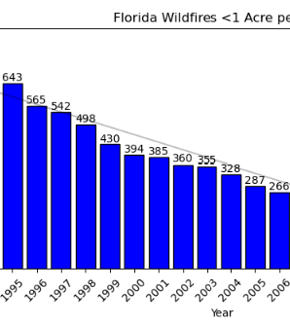

Question 3:
Have fire sizes changed over time? Is there a trend?

Slide 2

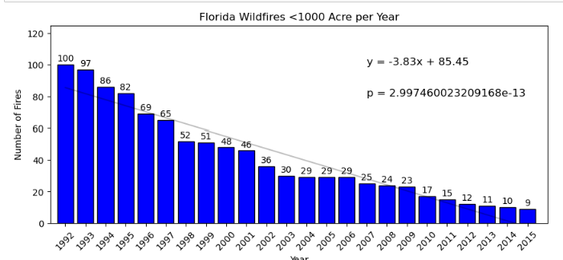
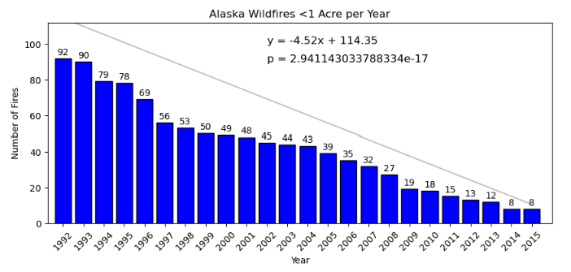
Have Fire Sizes Change over time?
The exact change in fire six over the years is a little difficult to determine. Between missing data, and thousands of fires, it extremely difficult to determine exact numbers.
If you look at the data in terms of averages, the average size of fires has decreased because the average number of fires has decreased per year.

Slide 3
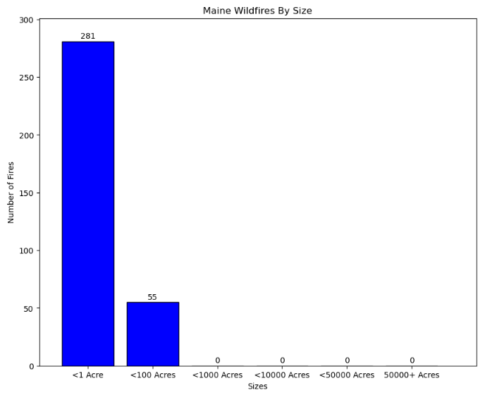
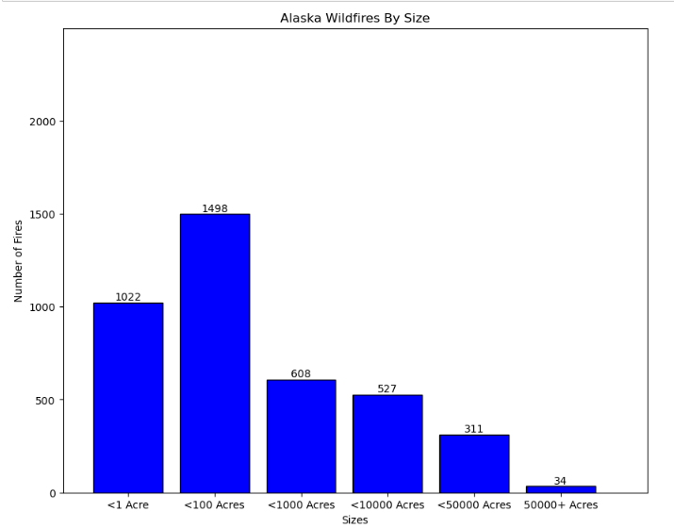
If you look at the date in terms of volume, the majority of the fires occurring have been within the less than one acre or less than one hundred acres categories.

Slide 4
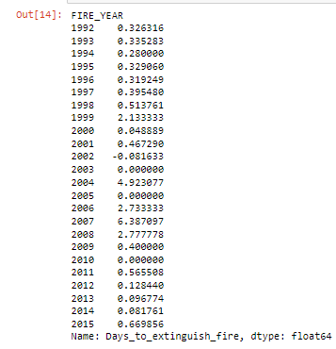
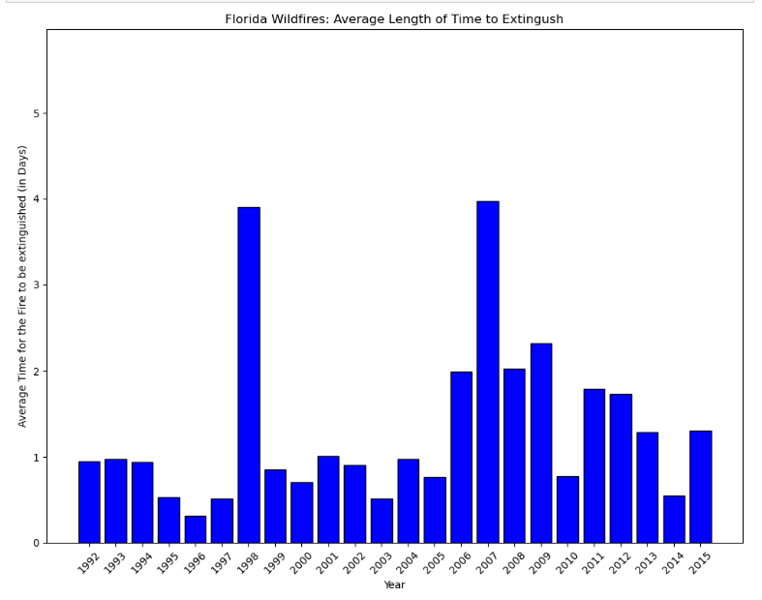
When one takes into account the time it takes for a fire to be extinguished as well, it shows a trend towards fire sizes being decreased over time.
The majority of fire were extinguished within a day, which reduces the amount of destruction a fire can cause.

Slide 5
In conclusion
Fires size over the years are on a negative trend, based on my data. They are being extinguished faster, there are less occurring each year, and the majority of those that do occur tend to be on the smaller side. Therefore, though there is no dramatically visible change in fire sizes based on the data, these three contributing factors indicate the beginning of a steady decline.

